Slide 1
GROUP 7
Viren Shashikant Chauhan
Radhika Dubey
Parth Hareshbhai Gabani
Jogendra Prasad Gali
Chinmay Hebbal
Yating Huang
Jaan Ashok Kesawalekar
MIS 6346.502- BIG DATA TRUCK Drivers Analysis and risk factors

Slide 2
Problem Statement: Our main responsibility as the fleet manager of AZ National Trucking (ANT) is to keep insurance risks down and make sure that driving recklessly doesn't violate any laws.
Objective:
• To find if the violations depend on the geographic locations.
• To find the contribution of trucks and drivers in the risk factor.
• To find if Risk factor is based on events.
• The relationship between miles driven and the number of incidents caused made by drivers.
Group 7

Slide 3
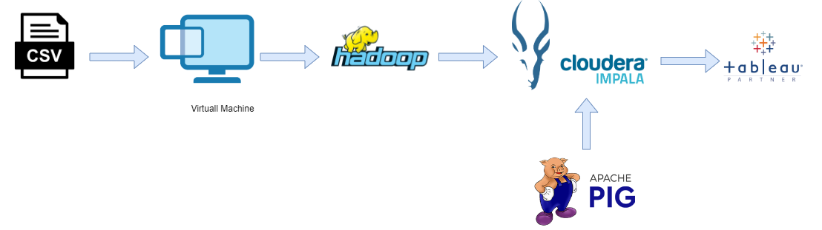
DATA FLOW PIPELINE
Group 7

Slide 4
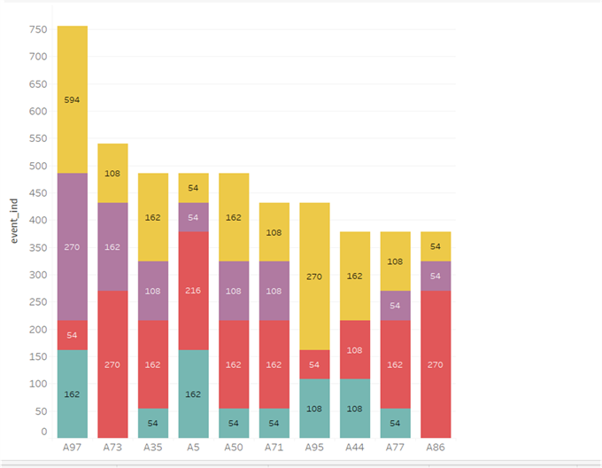
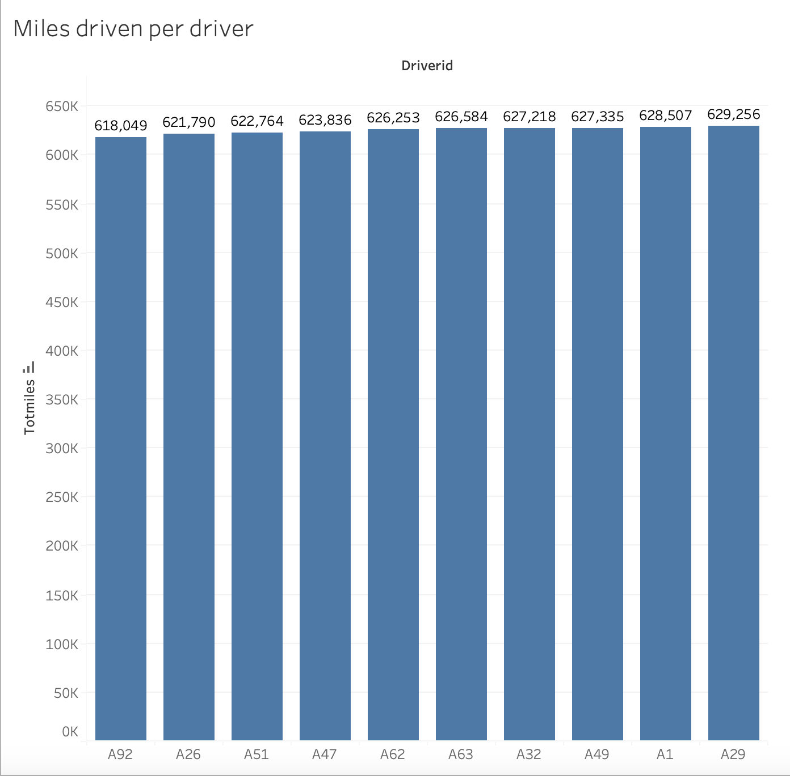
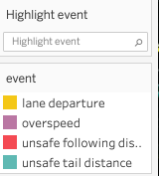
Events
OBSERVATIONS
ASSUMPTIONS
Events contributing to high risk factor are lane departure and unsafe following distance.
Driver experience levels
Highest no of accidents by drivers
Group 7

Slide 5
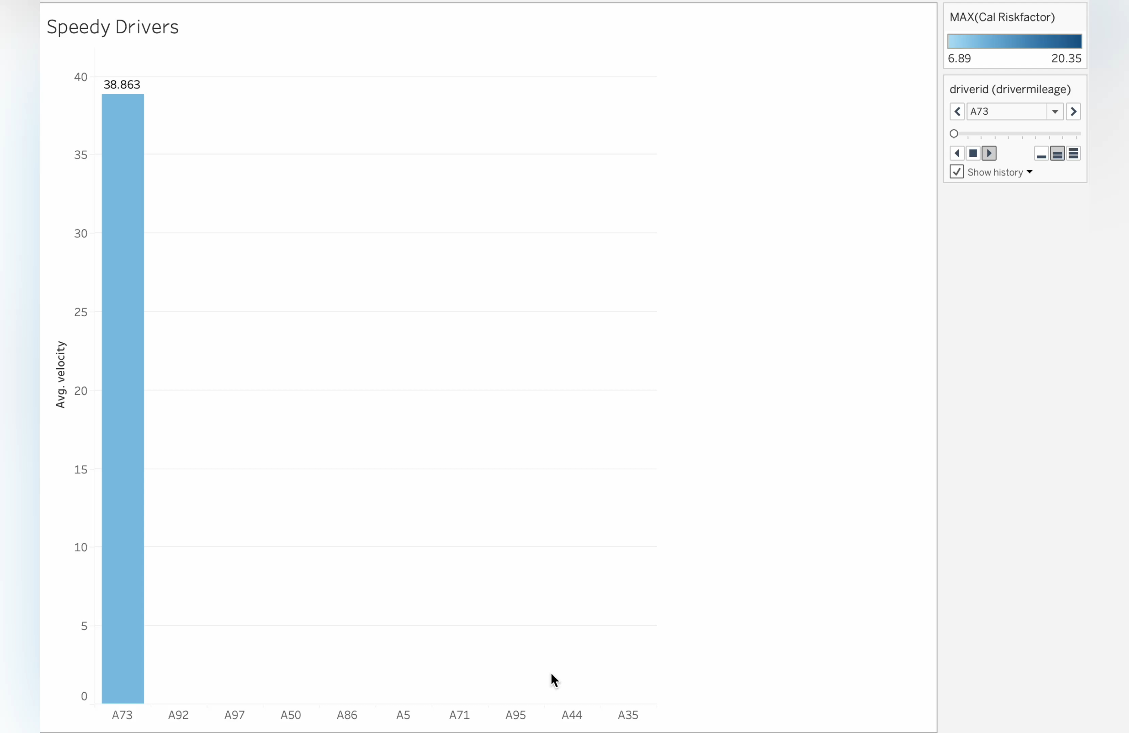
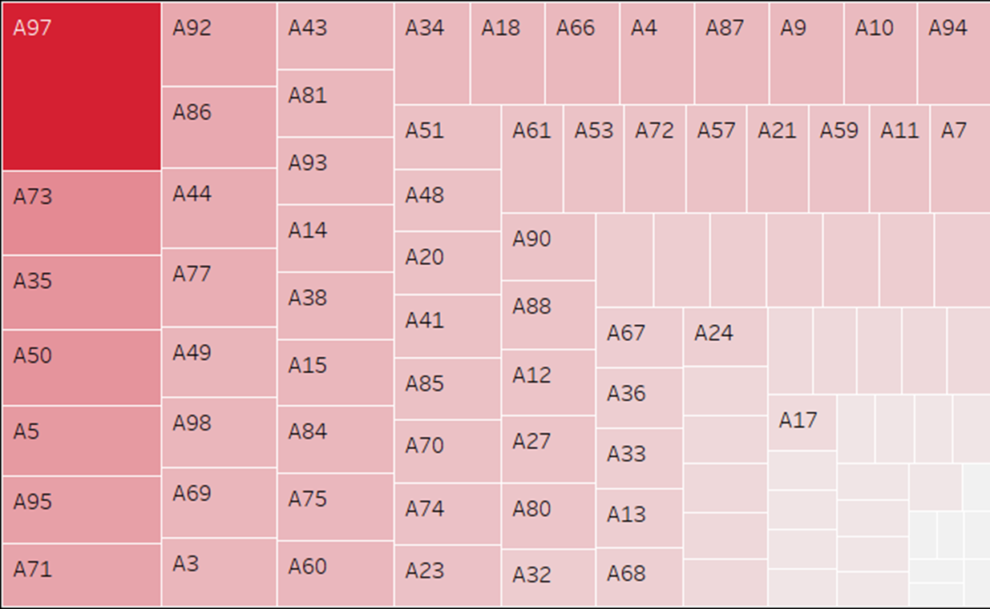
Driver
OBSERVATIONS
ASSUMTIONS
A97 has the highest risk factor followed by A73 and A35
A2 has the least risk factor followed by A65, A22 and A39
Average Speed
Speedier driver have highest risk factor
Group 7

Slide 6
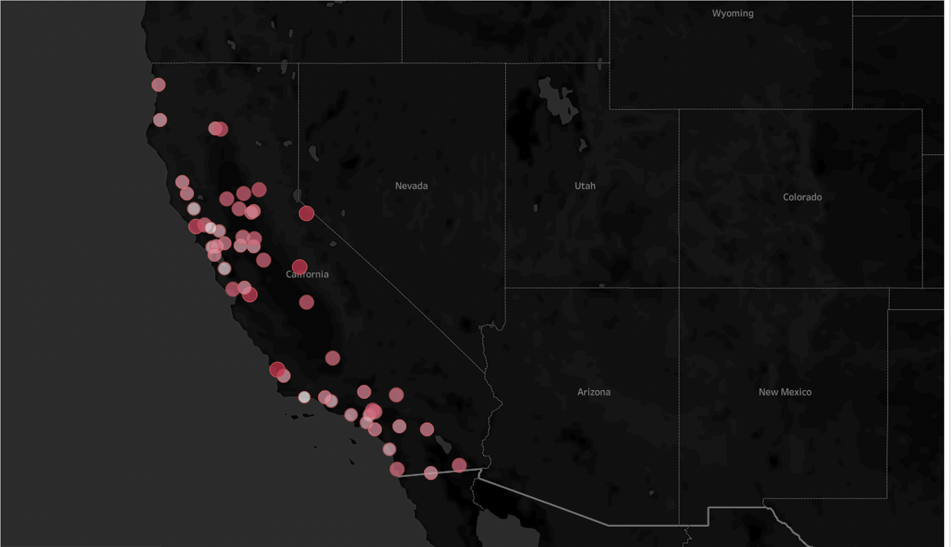
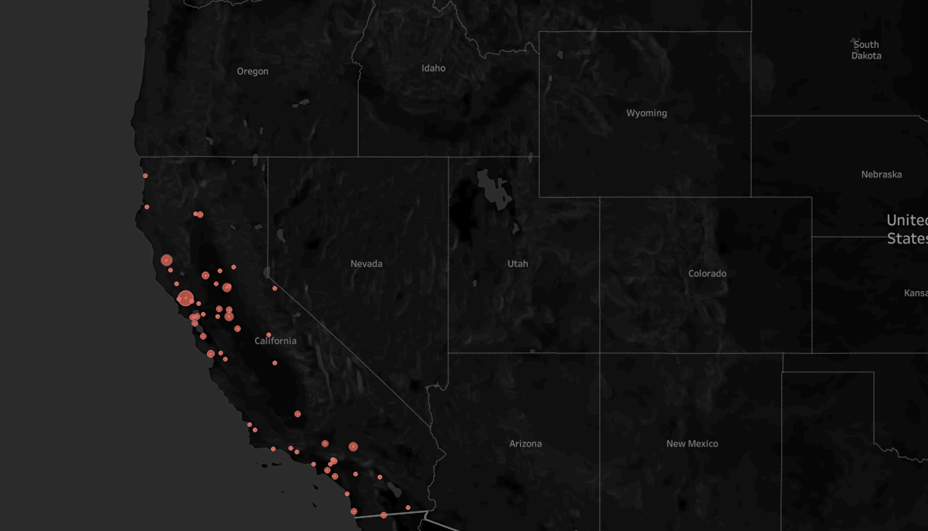
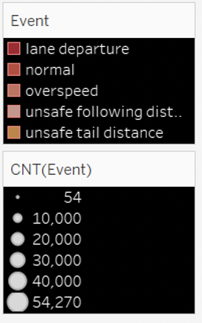
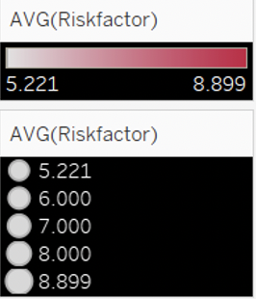
Location
OBSERVATIONS
ASSUMPTIONS
Cities in North California possess high risk factor than South California.
Risk factor depends on geographic location.
Santa Rosa – 1332.0
Goleta – 165.81.
Road/infrastructure quality varies by location
Average risk per location
Event distribution/Location
Group 7

Slide 7
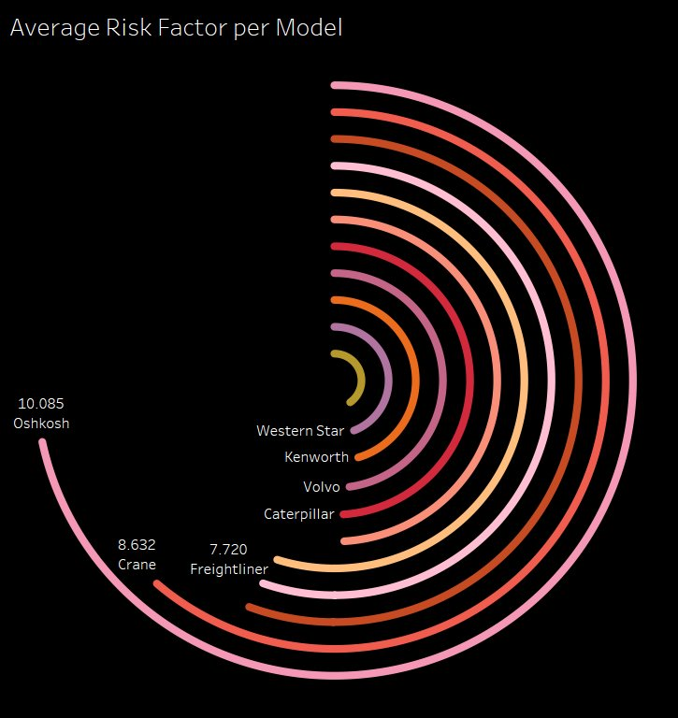
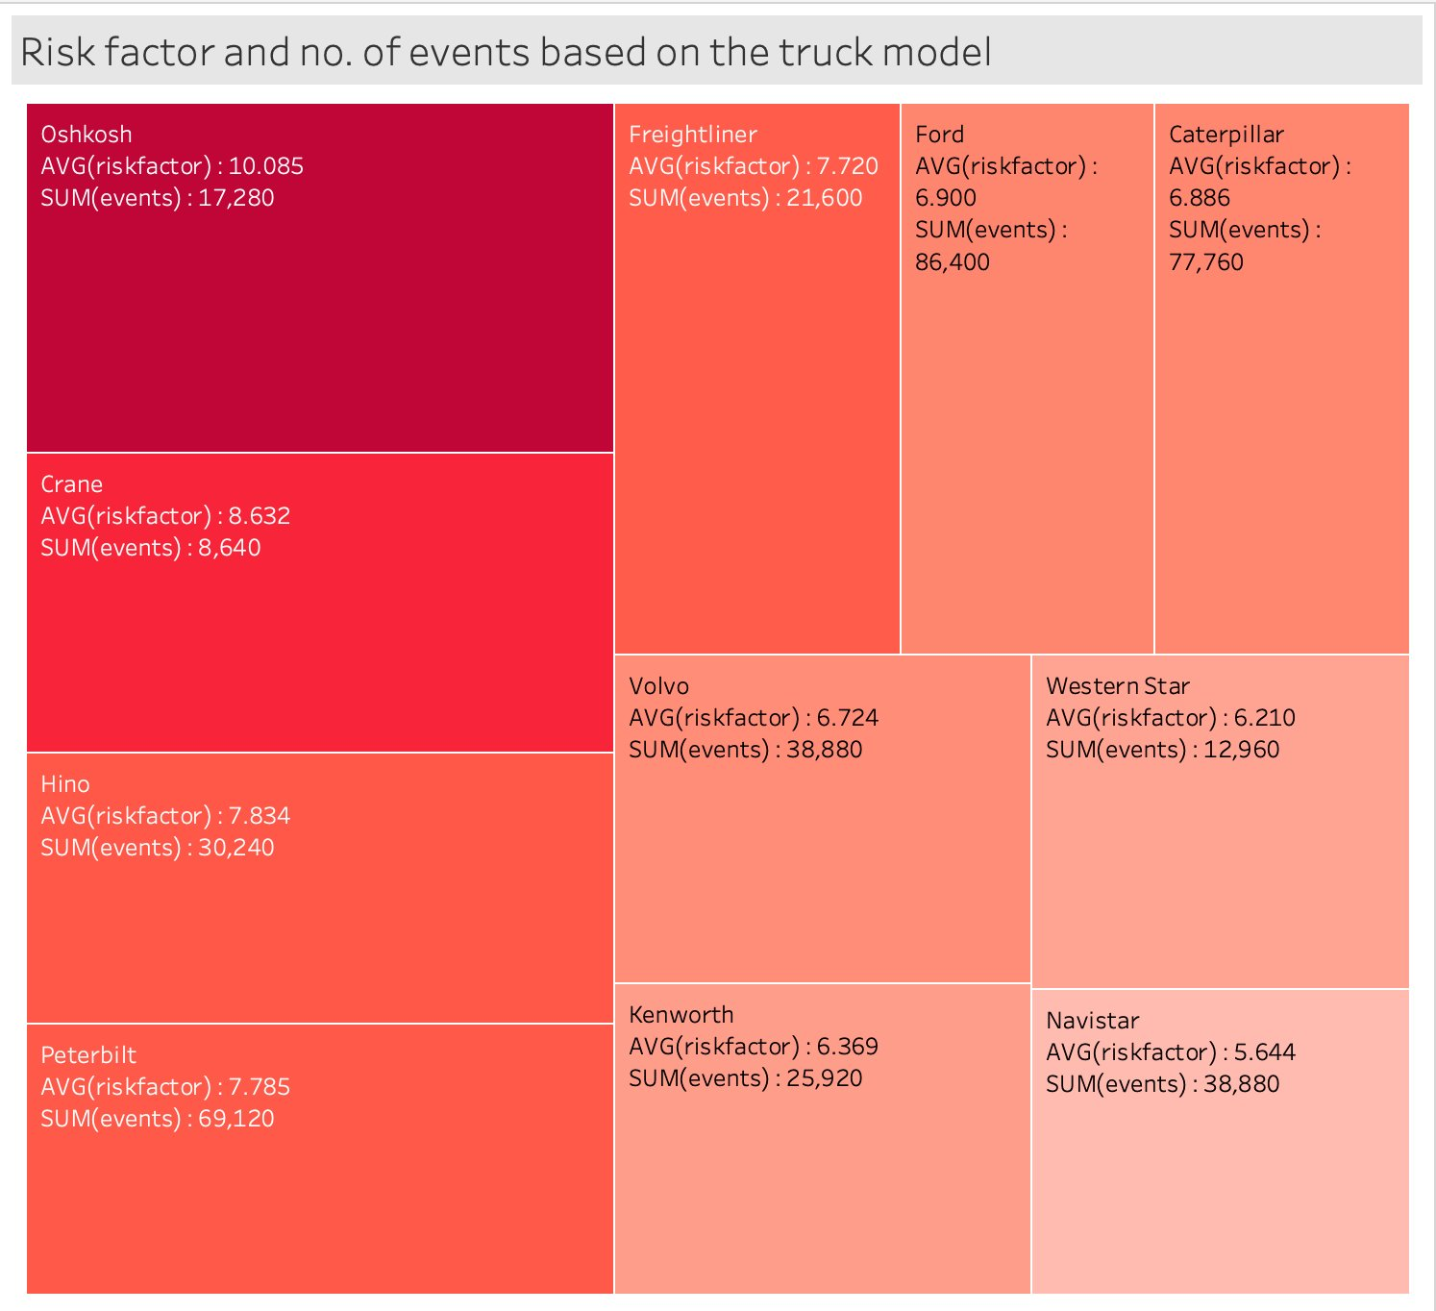
Trucks
OBSERVATIONS
ASSUMPTIONS
Oshkosh has the highest risk factor followed by Crane and Hino
Navistar has the least risk factor followed by Western Star and Kenworth
Ford, Caterpillar and Peterbilt add up to most count of our trucks
Design Flaws
Maintenance issue
Outdated Safety Features
Complexity of Systems
Group 7

Slide 8
Conclusion
Risk factor depends on external factors like geographic location, and it's directly proportional to events occurring.
Driver A97 exhibits the highest average risk factor, standing at 31.69. Notably, this driver appears frequently in 7 out of the top 10 cities. Need more efficient drivers to reduce average risk factor.
Invest in driver training by identifying driving patterns of risky and safe drivers to impart safe driving practices.
Least risky drivers can be assigned to cities or routes prone to more accidents and providing training to most risky drivers.
While Ford is associated with most incidents, Oshkosh brand trucks emerge as the riskiest overall.
Group 7

Slide 9


VOTE FOR GROUP - 7

